Slide 1
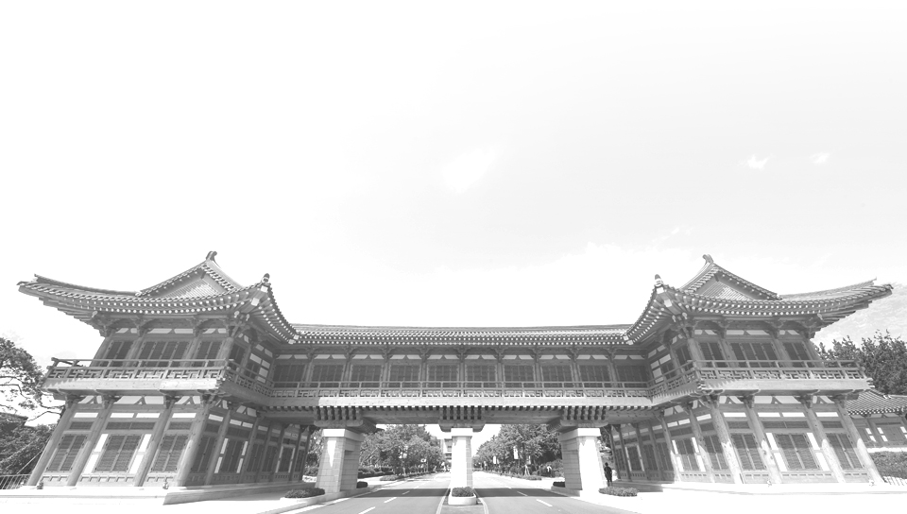


Linux Practice
JEONBUK NATIONAL UNIVERSITY

Slide 2
Contents
What is Linux
Why use Linux
Linux Booting Process

Slide 3
1
What is Linux
JEONBUK NATIONAL UNIVERSITY

Slide 4
•Just like Windows, iOS, and Mac OS, Linux is an operating system. In fact, one of the most popular platforms on the planet, Android, is powered by the Linux operating system.

Slide 5
•The Linux operating system comprises several different pieces
•Bootloader, Kernel, Init System, Daemons, Graphical server, Desktop environment, Applications

Slide 6
•Bootloader – The software that manages the boot process of your computer.
For most users, this will simply be a splash screen that pops up and eventually goes away to boot into the operating system.

Slide 7
•Kernel – This is the one piece of the whole that is actually called ‘Linux’.
The kernel is the core of the system and manages the CPU, memory, and peripheral devices. The kernel is the lowest level of the OS.

Slide 8
•Init system – This is a sub-system that bootstraps the user space and is charged with controlling daemons.
One of the most widely used init systems is systemd, which also happens to be one of the most controversial.
It is the init system that manages the boot process, once the initial booting is handed over from the bootloader (i.e., GRUB or GRand Unified Bootloader).

Slide 9
•Daemons – These are background services (printing, sound, scheduling, etc.) that either start up during boot or after you log into the desktop.

Slide 10
•Graphical server – This is the sub-system that displays the graphics on your monitor.
It is commonly referred to as the X server or just X.

Slide 11
•Desktop environment – This is the piece that the users actually interact with.
There are many desktop environments to choose from (GNOME, Cinnamon, Mate, Pantheon, Enlightenment, KDE, Xfce, etc.).
Each desktop environment includes built-in applications (such as file managers, configuration tools, web browsers, and games).

Slide 12
•Applications – Desktop environments do not offer the full array of apps.
Just like Windows and macOS, Linux offers thousands upon thousands of high-quality software titles that can be easily found and installed.
Most modern Linux distributions (more on this below) include App Store-like tools that centralize and simplify application installation.
For example, Ubuntu Linux has the Ubuntu Software Center (a rebrand of GNOME Software) which allows you to quickly search among the thousands of apps and install them from one centralized location.

Slide 13
2
Why use Linux
JEONBUK NATIONAL UNIVERSITY

Slide 14
•Linux has evolved into one of the most reliable computer ecosystems on the planet. Combine that reliability with zero cost of entry and you have the perfect solution for a desktop platform.

Slide 15
3
Linux Booting Process
JEONBUK NATIONAL UNIVERSITY

Slide 16
1. BIOS
BIOS stands for Basic Input/Output System. In simple terms, the BIOS loads and executes the Master Boot Record (MBR) boot loader.
When you first turn on your computer, the BIOS first performs some integrity checks of the HDD or SSD.
Then, the BIOS searches for, loads, and executes the boot loader program, which can be found in the Master Boot Record (MBR). The MBR is sometimes on a USB stick or CD-ROM such as with a live installation of Linux.
Once the boot loader program is detected, it's then loaded into memory and the BIOS gives control of the system to it.

Slide 17
2. MBR
MBR stands for Master Boot Record, and is responsible for loading and executing the GRUB boot loader.
The MBR is located in the 1st sector of the bootable disk, which is typically /dev/hda, or /dev/sda , depending on your hardware. The MBR also contains information about GRUB, or LILO in very old systems.

Slide 18
3. GRUB
Sometimes called GNU GRUB, which is short for GNU GRand Unified Bootloader, is the typical boot loader for most modern Linux systems.
The GRUB splash screen is often the first thing you see when you boot your computer. It has a simple menu where you can select some options. If you have multiple kernel images installed, you can use your keyboard to select the one you want your system to boot with. By default, the latest kernel image is selected.
The splash screen will wait a few seconds for you to select and option. If you don't, it will load the default kernel image.

Slide 19
4. Kernel
The kernel is often referred to as the core of any operating system, Linux included. It has complete control over everything in your system.
In this stage of the boot process, the kernel that was selected by GRUB first mounts the root file system that's specified in the grub.conf file. Then it executes the /sbin/init program, which is always the first program to be executed. You can confirm this with its process id (PID), which should always be 1.
The kernel then establishes a temporary root file system using Initial RAM Disk (initrd) until the real file system is mounted.

Slide 20
5. Init
At this point, your system executes runlevel programs. At one point it would look for an init file, usually found at /etc/inittab to decide the Linux run level.

Slide 21
6. Runlevel programs
Depending on which Linux distribution you have installed, you may be able to see different services getting started.

Slide 22
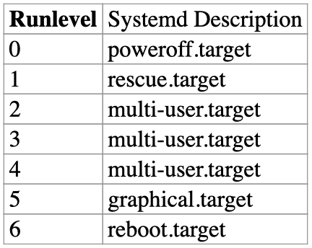
A runlevel defines the state of the machine after boot. In simpler terms, a runlevel is a configurable mode of operation in which the system enters after boot and runs the startup scripts associated with that runlevel.

Slide 23
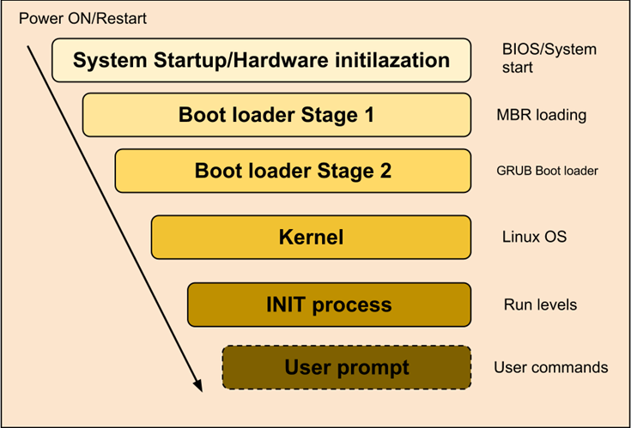

Slide 24
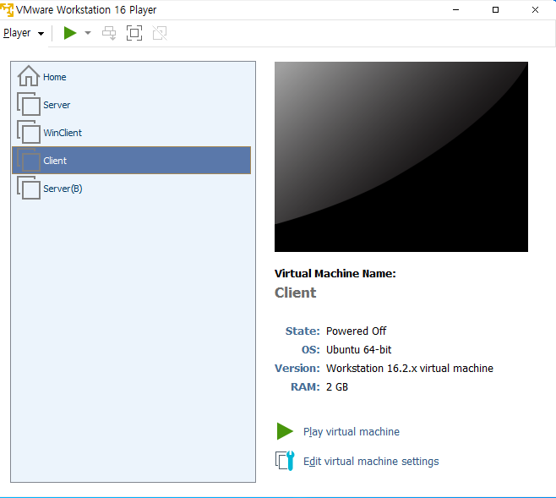

Slide 25
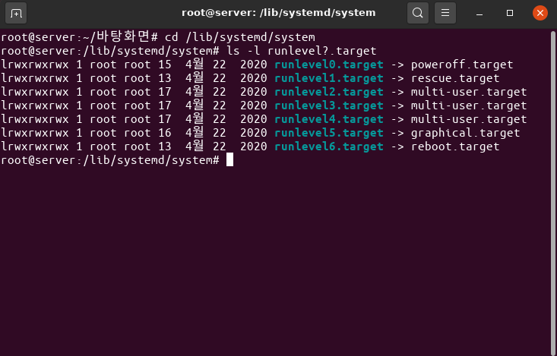

Slide 26
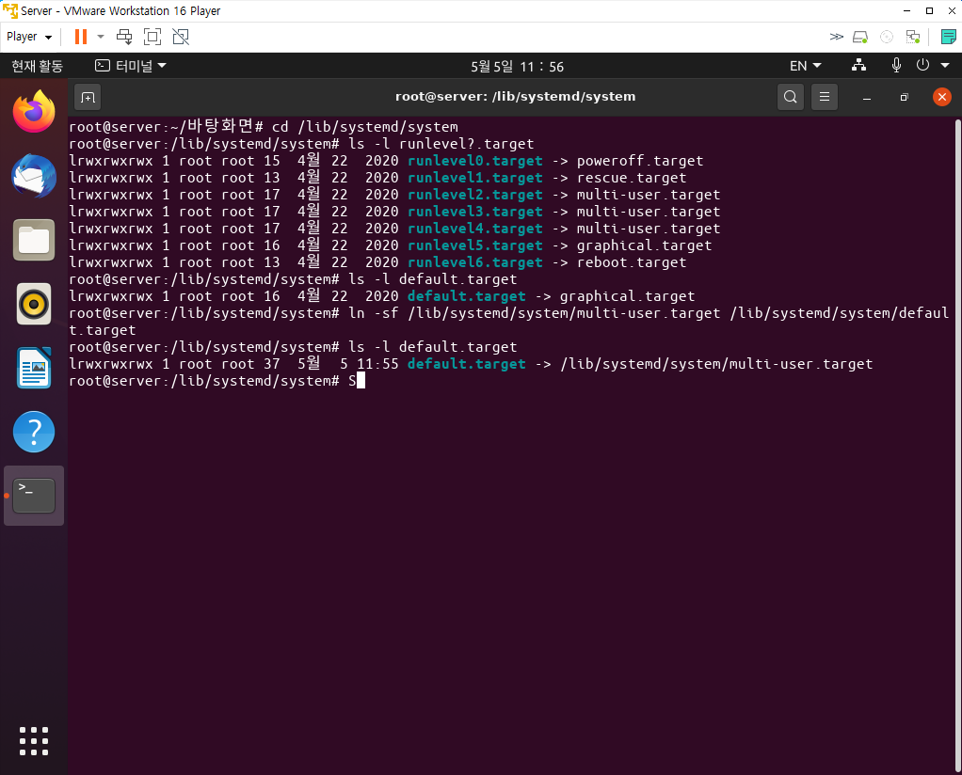

Slide 27
